Slide 1
Loan Risk Analytics EDA case Study
Understanding Data to Mitigate Risks
Vishal Verma
Vinti Singh

Slide 2
Introduction
What is EDA? A preliminary analysis process to summarize the main characteristics of the data.
Why is EDA important for loan risk analytics?
Identifies patterns and anomalies.
Provides insights for feature engineering.
Improves model performance by cleaning and understanding data.

Slide 3
EDA workflow
Data Understanding:
Inspect the dataset structure (dimensions, types, and summary).
Data Cleaning:
Handle missing values.
Remove duplicates and correct data types.
Outlier Detection and Treatment.
Univariate Analysis:
Examine each variable’s distribution.
Bivariate Analysis:
Explore relationships between independent variables and the target.
Multivariate Analysis:
Feature Engineering and Insights.

Slide 4
emp_length
Data Cleaning
Issues Identified:
Removing irrelevant columns as per Data Dictionary sheet.
Missing values in employee year of service and public record bankruptcies columns.
Resolution:
Imputation techniques (mean, median, mode).
Converting dates into numerical formats (e.g., year since application).

Slide 5
Outlier Treatment
Techniques Used:
Boxplots to detect anomalies in loan amount, income, etc.
IQR methods to quantify outliers.
Resolution:
Cap extreme values for variables like income or loan amount.
Verify outliers for potential fraud indicators.
Standardization techniques .

Slide 6
Univariate Analysis
Numerical Features:
Distribution of DTI, loan amounts, interest rates, term, verification status, Installment , and income using histograms.
Key statistics (mean, median, standard deviation).
Categorical Features:
Count plots for loan status, Grade, and ownership of the loan applicant.
Insights:
Most loans applied from rented peoples .
Majority of applicants fall into the mid-income bracket.

Slide 7
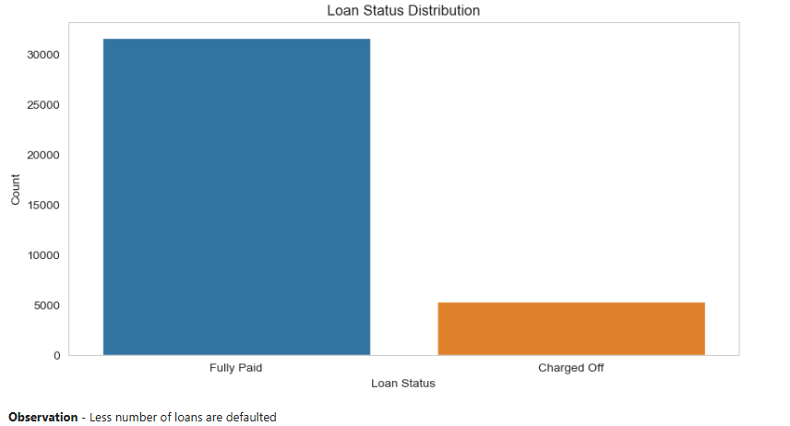
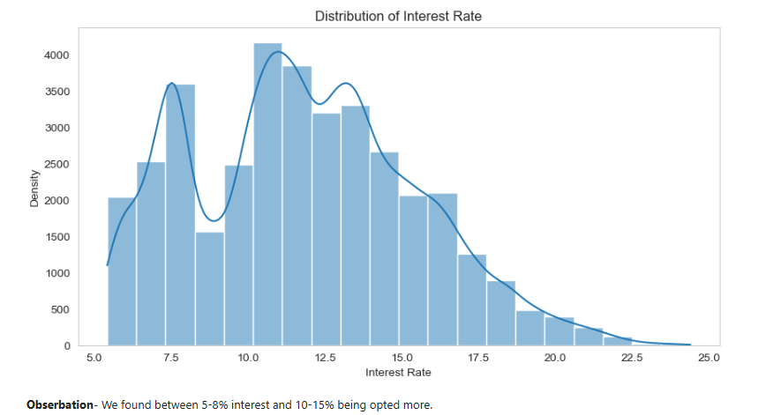
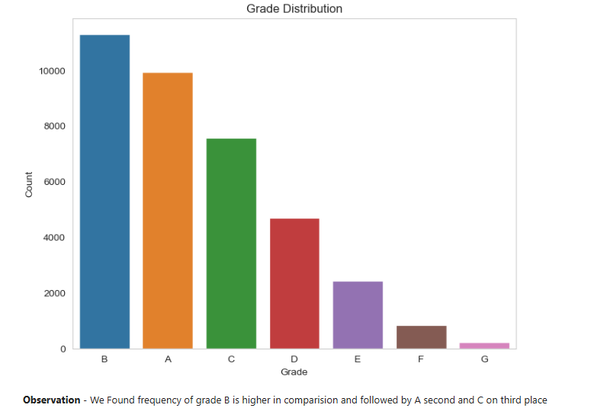
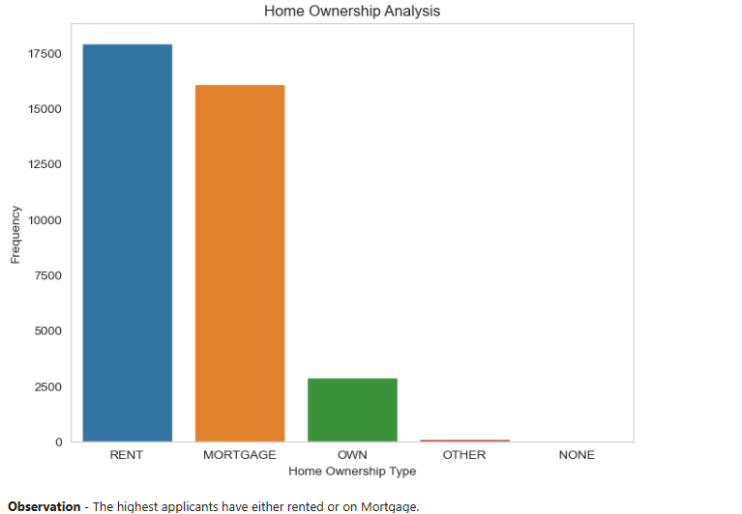
Univariate Analysis

Slide 8
Bivariate Analysis
Bivariate analysis b/w Features:
Interest rate vs grade (Bar Plot)
Purpose vs loan status (Count Plot)
term vs Interest rate (Bar Plot)
Loan status vs State(Count Plot)
Loan status vs home ownership(Count Plot)
Loan status vs loan amount (Dist Plot)
Emp Length vs Interest rate (Hist Plot)
Key Findings:
Default rates are higher for lower credit scores.
Default rates are higher for high rate of interest

Slide 9
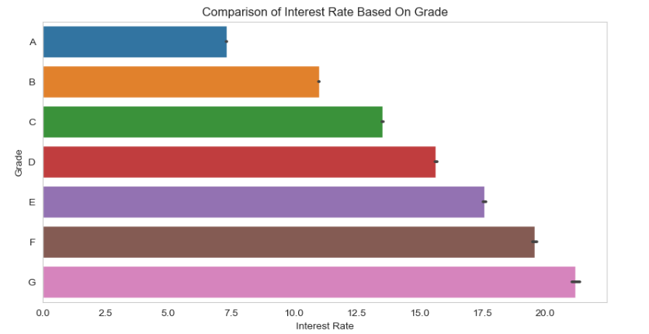
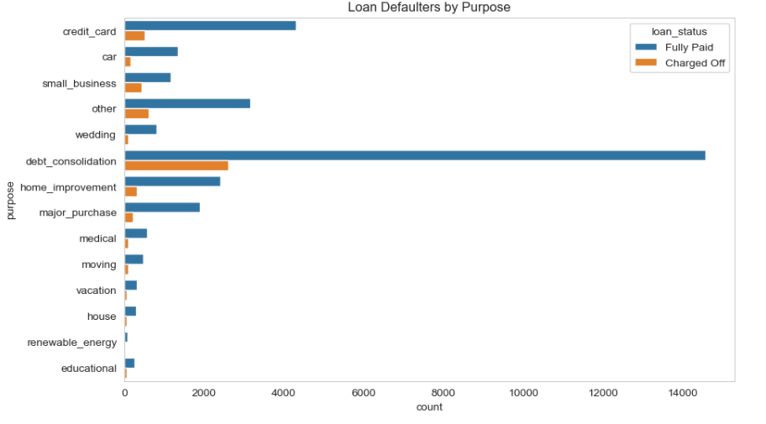
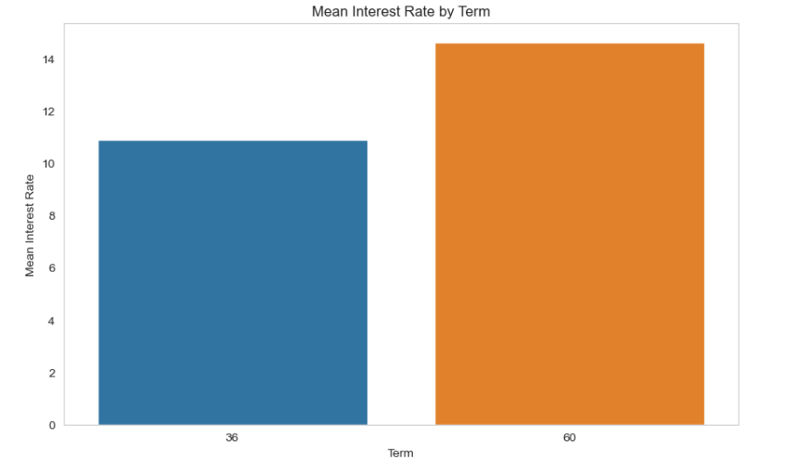
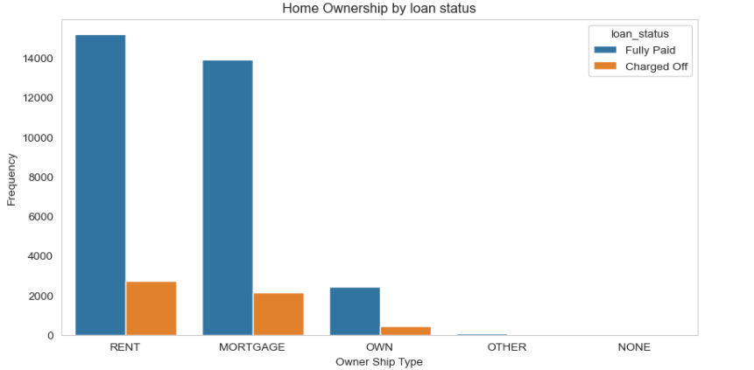
Bivariate Analysis

Slide 10
Multivariate Analysis
Correlation Heatmap:
Relationship between numerical features (e.g., loan amount, loan status, income, Dti).
Key Findings:
Default rates are higher for lower credit scores.
High loan amounts with low-income borrowers show increased risks.

Slide 11
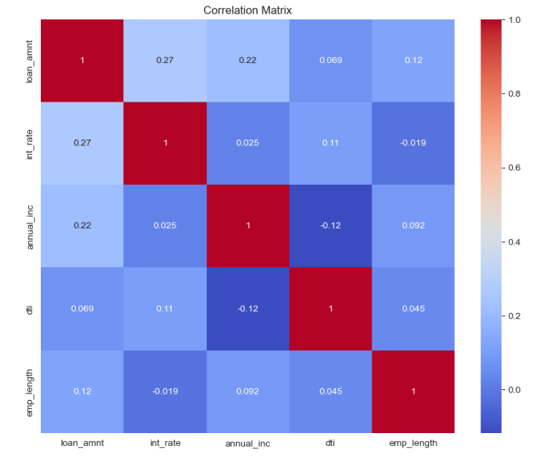
Multivariate Analysis

Slide 12
Conclusion
Summary of EDA Findings:
Data is ready for advanced modeling after cleaning and preprocessing.
Key risk factors have been identified for predictive modeling.
Next Steps:
Develop risk prediction models using insights from EDA.
Continuously monitor data quality for future analyses.

